Slide 1
Medical Image Seminar
Luyue Shi
March 26, 2020

Slide 2
Multi-scale GANs for Memory-efficient Generation of High Resolution Medical Images
Hristina Uzunova¹, Jan Ehrhardt¹, Fabian Jacob², Alex Frydrychowicz², and Heinz Handels¹
¹Institute of Medical Informatics, University of Lu ̈beck, Lu ̈beck, Germany
uzunova@imi.uni-luebeck.de ² Department for Radiology and Nuclear Medicine,
University Hospital of Schleswig-Holstein, Lu ̈beck, Germany

Slide 3
Introduction
Topic: Generating large high resolution 2D and 3D medical images using GANs
Main problem: Computational demand
Key idea: First learn a low-resolution version of the image and then generate patches of successively growing resolutions conditioned on previous scales.

Slide 4
Introduction
Related Work
Challenges for generating high resolution images of large size:
1. generated images are easier to distinguish from real ones at higher resolutions, which hinders the training process
2. memory requirements
Existing solutions:
1. PG-GAN
Progressive learning strategy for GANs that starts with low resolution and adds finer details throughout the training, solving the first problem.
Weakness: high memory requirement
2. Slice-/Patch- wise generation
Weakness: artifacts between patches/slices due to noncontinuous transitions ==>patch overlaps and averaging==>blurry results and loss of image detail

Slide 5
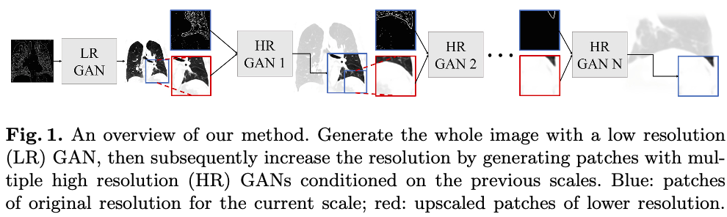
Model
LR GAN
Generating the whole image with low resolution from edges image
Generator: U-Net architecture
Discriminator: Regular fully-convolutional architecture

Slide 6
Model
HR GANs
Input: a patch from the image of the previous resolution, upscaled to the size of the current scale; and a patch from the edge image of the current scale.
Generators: ResNet blocks
Discriminator: Regular fully-convolutional architecture

Slide 7
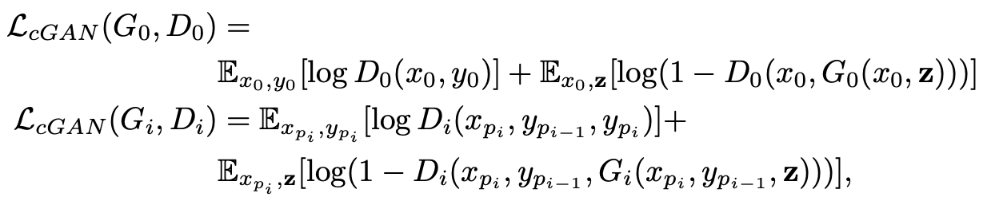
Model

Slide 8
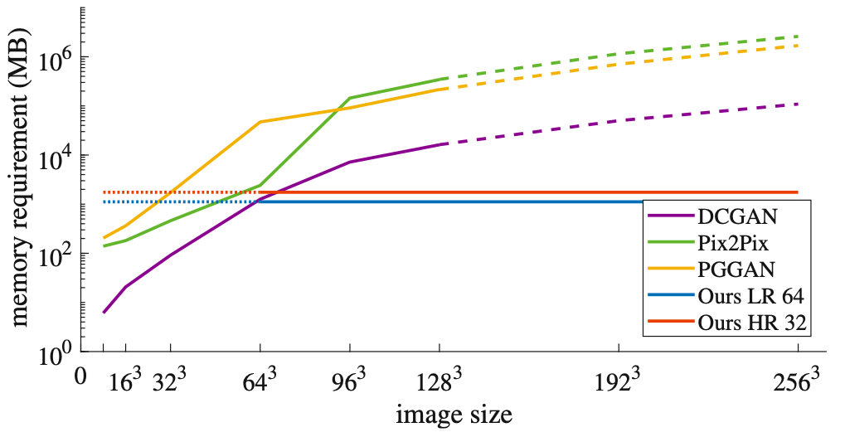
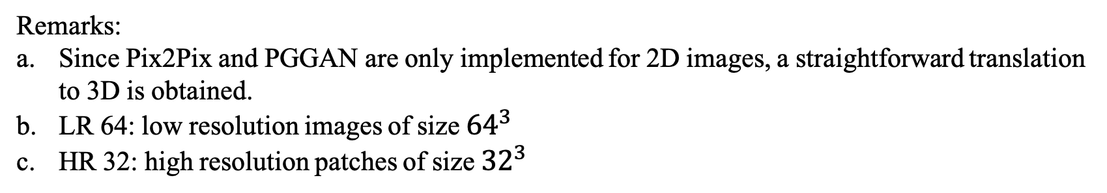
Experiment and Results
Memory Requirement
Remarks:
Since Pix2Pix and PGGAN are only implemented for 2D images, a straightforward translation to 3D is obtained.
LR 64: low resolution images of size ${64}^{3}$
HR 32: high resolution patches of size ${32}^{3}$

Slide 9
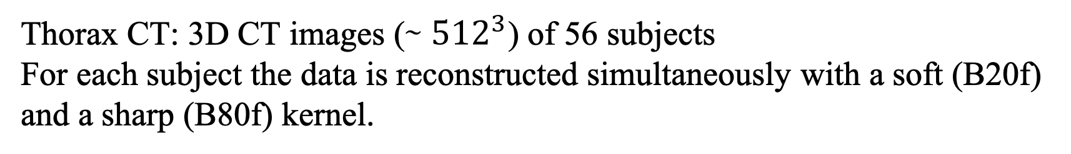
Experiment and Results
Experiment 1
Dataset
Thorax CT: 3D CT images (∼ ${512}^{3}$) of 56 subjects
For each subject the data is reconstructed simultaneously with a soft (B20f) and a sharp (B80f) kernel.
Setup
B80f to B20f CTs domain translation:
Train: the GANs are trained on the B20f images
Test: the edges from the B80f images are extracted and translated into the B20f domain

Slide 10
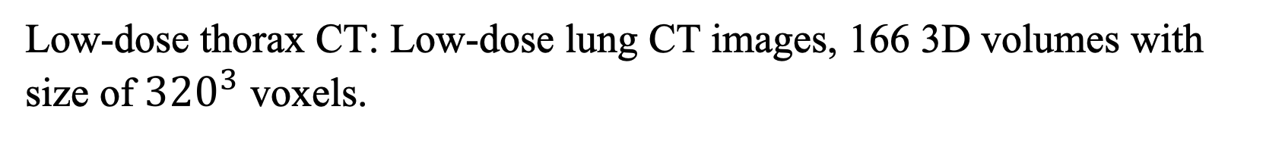
Experiment and Results
Experiment 2
Dataset
Thorax CT dataset in experiment 1
Low-dose thorax CT: Low-dose lung CT images, 166 3D volumes with size of ${320}^{3}$ voxels.
Setup
Low-dose to high-dose domain translation:
Train: high-dose B20f images from the thorax dataset
Test: edges extracted from the low-dose data

Slide 11
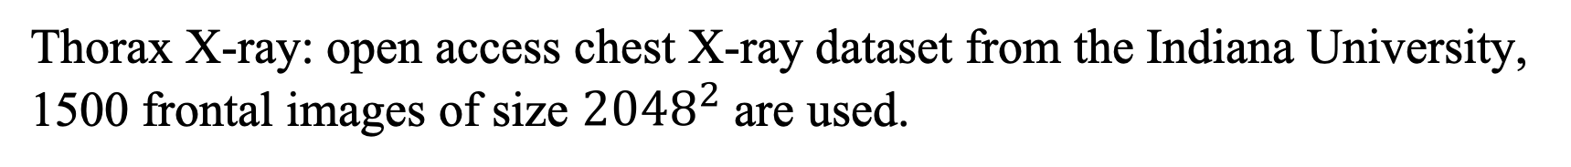
Experiment and Results
Experiment 3
Dataset
Thorax X-ray: open access chest X-ray dataset from the Indiana University, 1500 frontal images of size ${2048}^{2}$ are used.
Setup
Large 2D image generation:
90% of the thorax X-ray datasets are used for training, whereas the rest of the images is used for testing

Slide 12
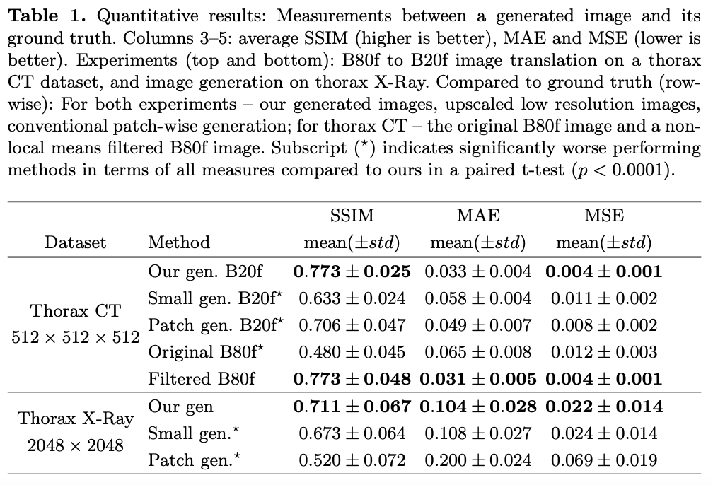
Experiment and Results
Experiment Results
Experiment 1, 3

Slide 13
Experiment and Results
Experiment Results
Experiment 2
Frechet Inception Distance (FID)
the original low- dose and the original high-dose images (150)
the translated and the original high-dose images (131)
the translated and the original low-dose images (157)

Slide 14
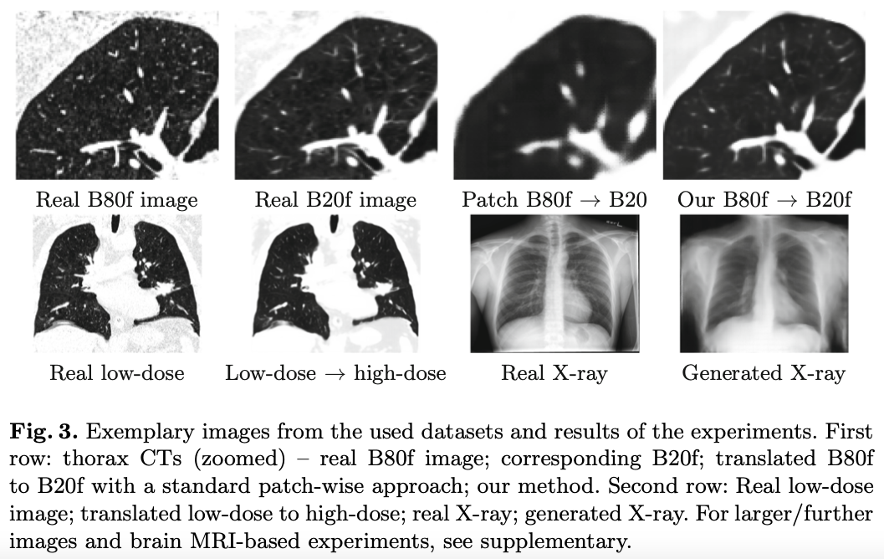
Experiment and Results
Experiment Results

Slide 15
Experiment and Results
Paper List
PG-GAN: Progressive growing of GANs for improved quality, stability, and variation
Efficient multi-scale 3D CNN with fully connected CRF for accurate brain lesion segmentation
MRI-based synthetic CT generation using deep convolutional neural network
StackGAN++: realistic image synthesis with stacked generative adversarial networks

